Slide 1
Road Accidents in Canada Explored (Project RACE)
Presented by:
Syed Tasrif Ahmed -
Tolu Fatoki - 200384759
July 10, 2020

Slide 2
TEAM MEMBERS AND TASK
Team Member | Task
Tolu Fatoki | Data Analysis and Exploration with python, Build machine learning model, Testing Project Documentation
Syed Tasrif Ahmed | Web development, Build interactive visuals with chart.js, Build Machine learning model, Testing ,Documentation

Slide 3
Outline
Introduction
Solution Overview
Methodology
Results
Limitation
Conclusion

Slide 4
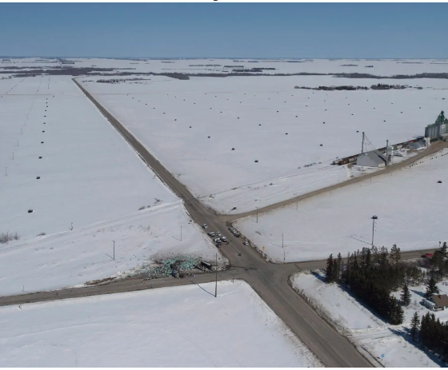
Introduction
The importance of road transport to any country and its economy and keeping the roads safe is a top priority for any government
US crash record in 2015 shows that 47% of road accidents occurred at intersections and also in Ontario, Canada 42% of accidents are intersection related
The government Canada has an initiative to achieve road safety with its Road Safety Strategy 2025
Our aim is to help the government in achieving this goal with the help of machine learning

Slide 5
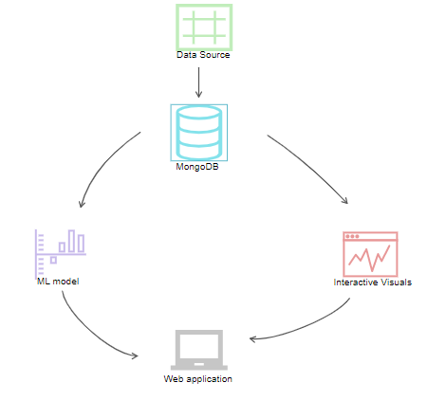
Solution Overview

Slide 6
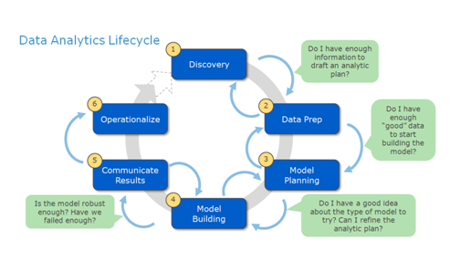
Methodology

Slide 7
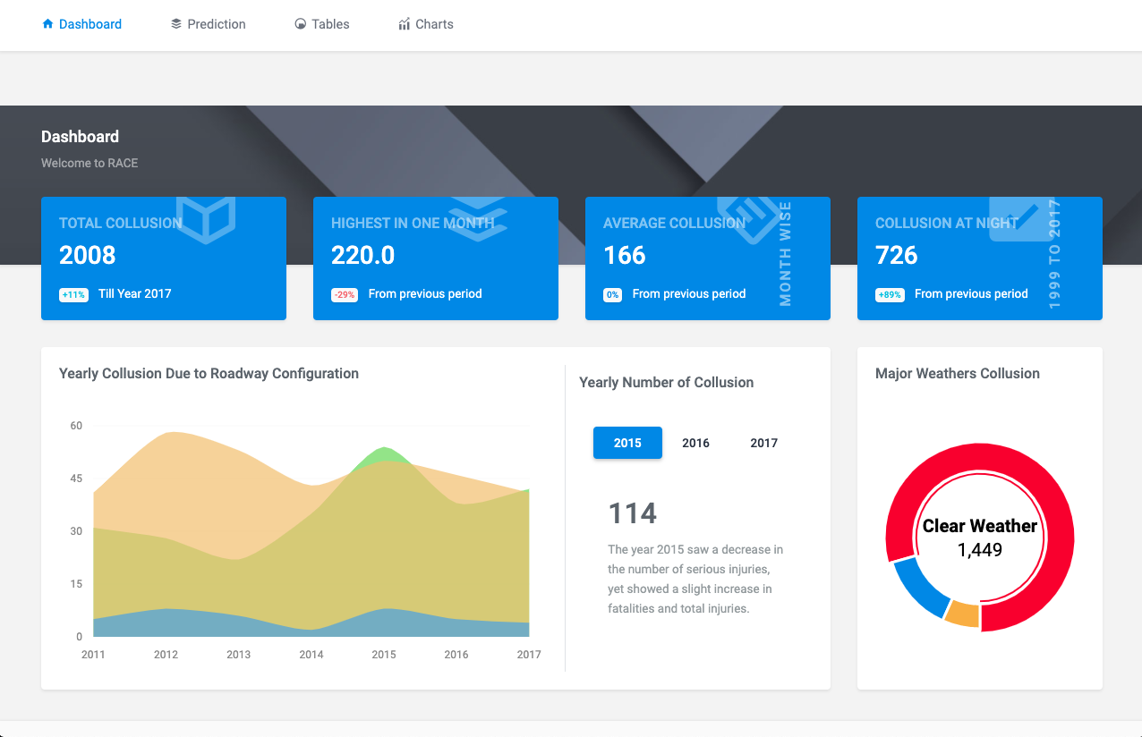
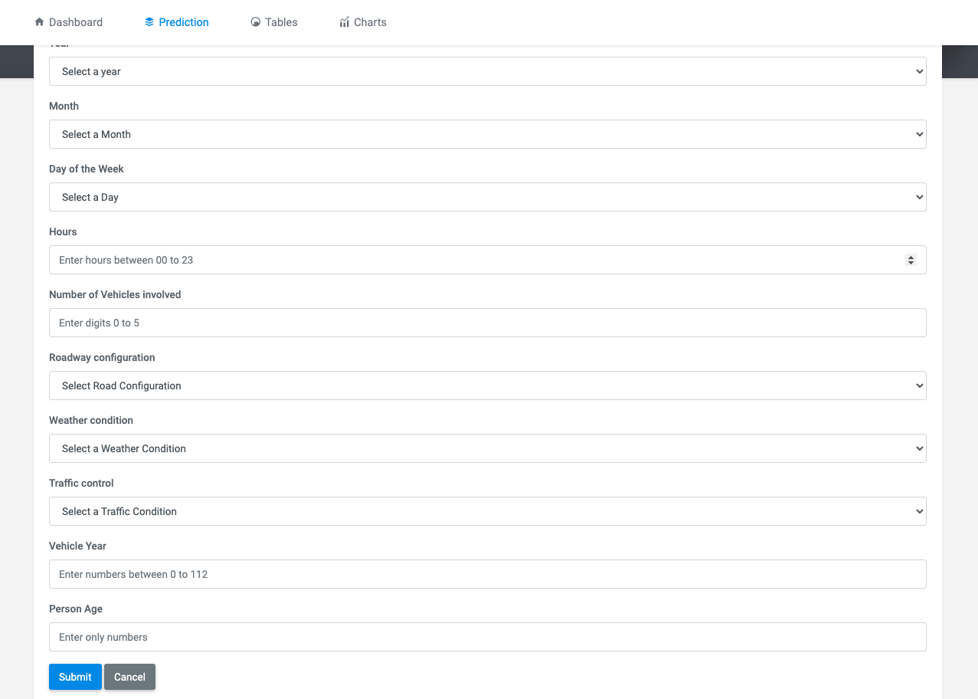
Result

Slide 8
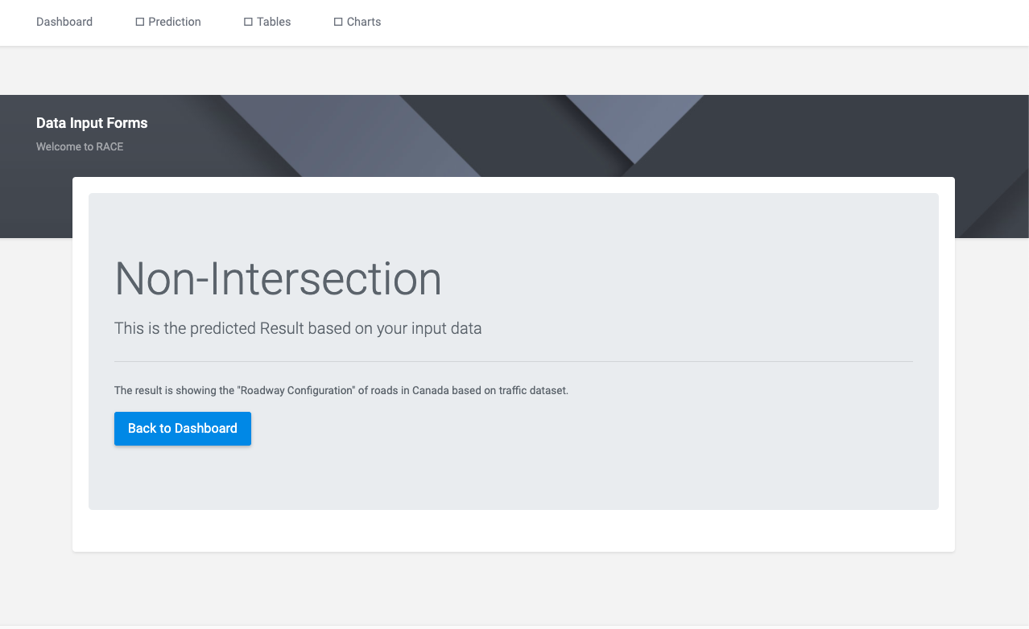
Result

Slide 9
Actionable Insight
Find out the vulnerable road configurations.
Put more measures on those configurations like stops signs or signals or pedestrian make a foot over bridge

Slide 10
Limitation
Large dataset, the selected data was large and storing and accessing it for both the python analysis and web application development was a great concern
Due to the pandemic during the execution of the project, we could not physically reach out to stakeholders to hold the necessary meetings and gather important requirements from them
Lack of sophisticated machines made our development process slower than expected which affected building the machine learning model and executing it in the web application.

Slide 11
Conclusion
In this report we have highlighted the process within the data analytic lifecycle that we employed to execute the process of predicting road accidents at different identified hotspots within Canada. Our dataset was gotten from the government of Canada website and with this dataset we built a machine learning model using the random forest algorithm that can make prediction of the collision hotspots within Canada. We ultimately built a website where users can interact with different features of the dataset and the predictive model. All of our project files, codes and guides can be found the github repository provided here.

